Slide 1




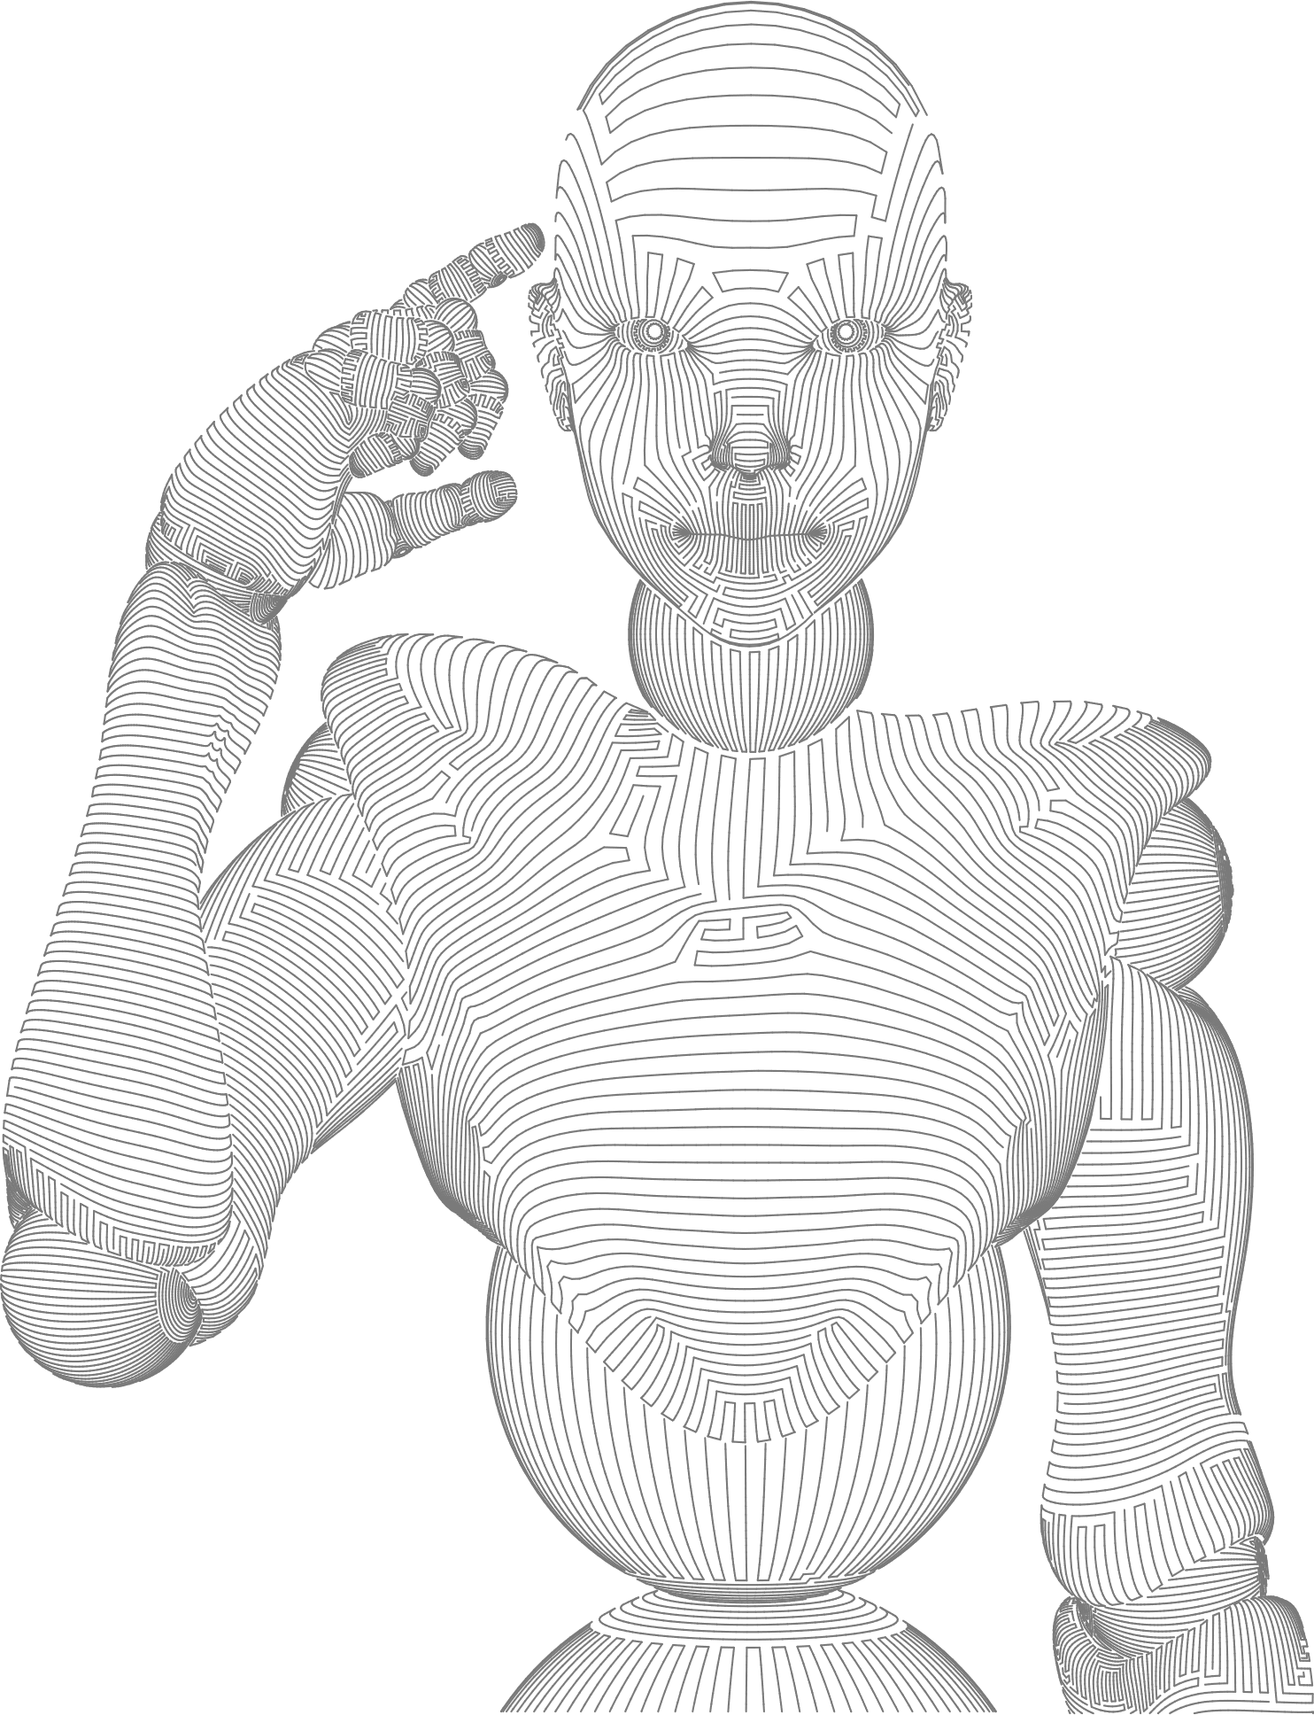
WORKSHOP
Community - Machine Learning for HEP
Towards the dripline: Nuclear Lattice Effective Field Theory approach
Young-Ho Song
Researcher
IRIS(Institute for Rare Isotope Science), IBS(Institute for Basic Science)

Slide 2
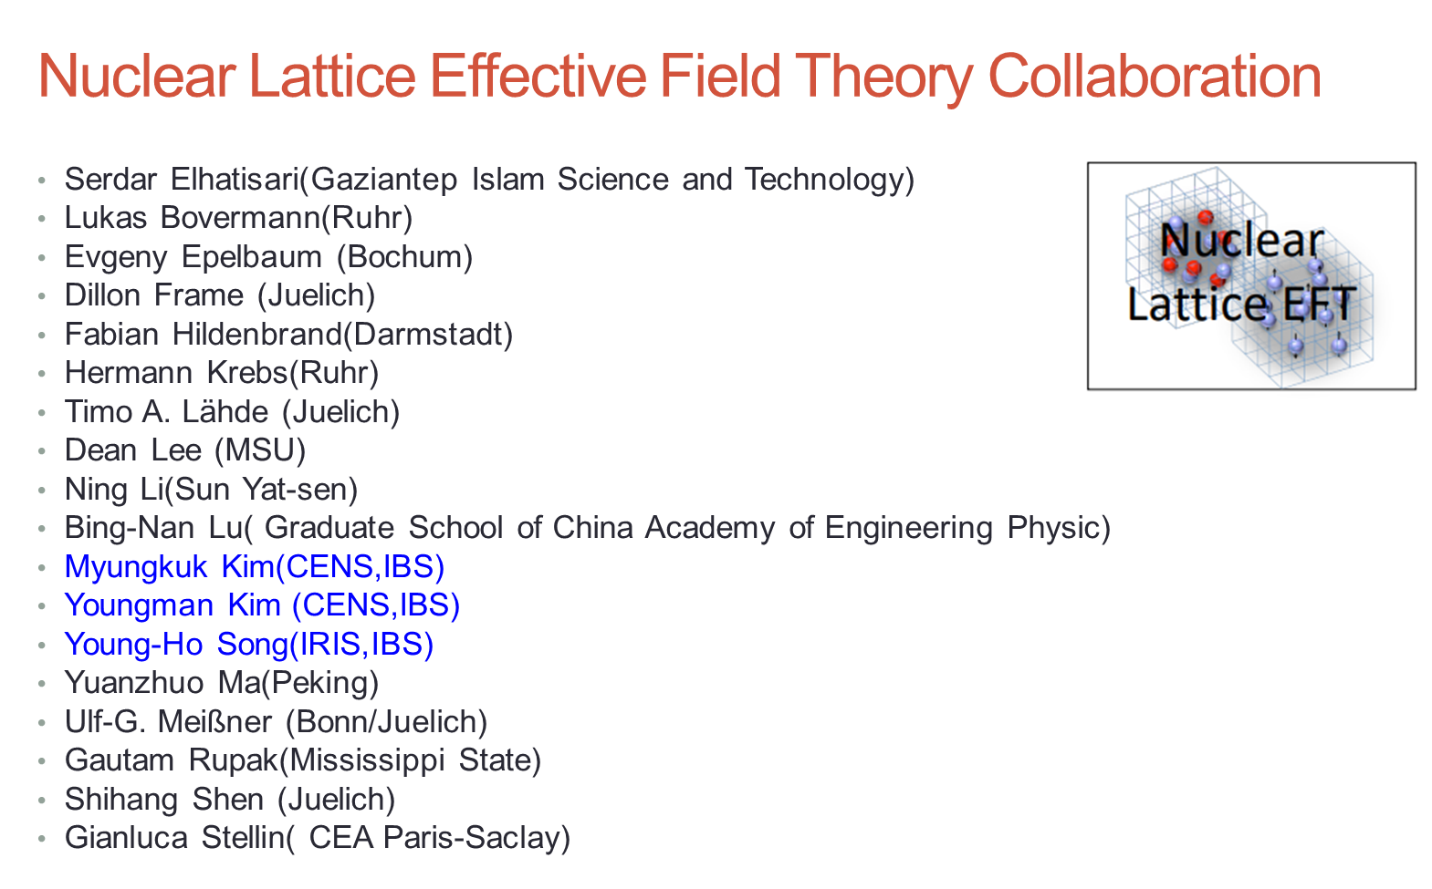


Slide 3
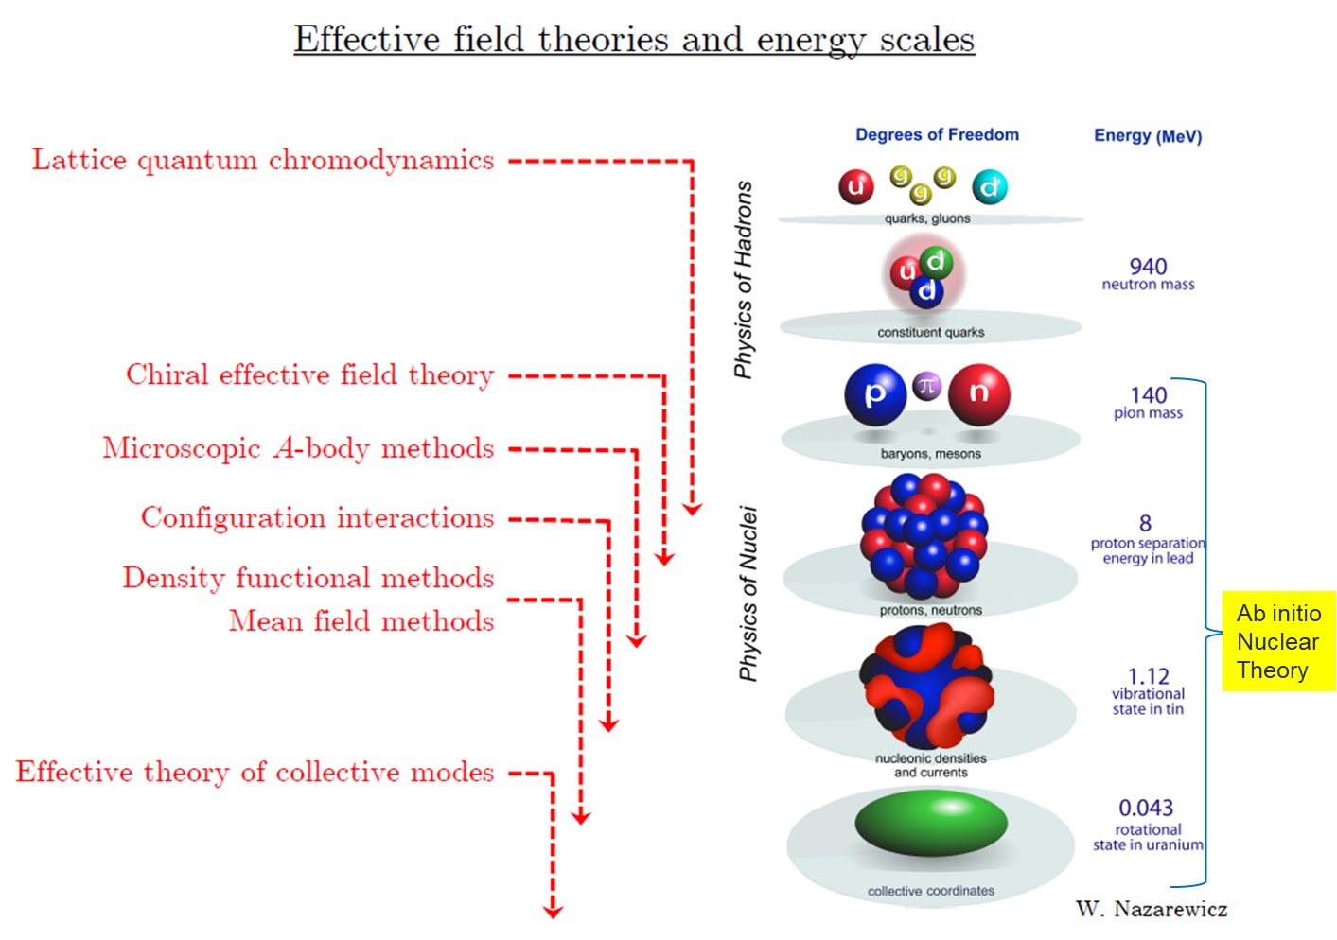
ab-initio Nuclear Physics
(1) nucleon degrees of freedom
(2) nucleon-nucleon interaction
Goal: predict wide range(structure, reaction, nuclear matter) of nuclear phenomena (without parameter fitting, model assumption) from nuclear interaction (for 2-body,3-body, many-body, based on QCD)
Difficulty:
Fundamental interaction between nucleons (NN interaction, 3N interaction) are not fully determined yet.
Quantum many problem

Slide 4
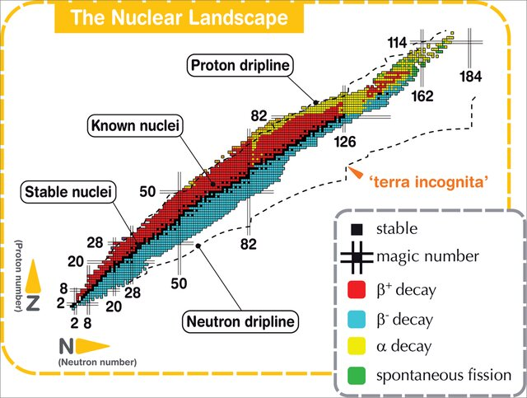
Ab initio many-body
(ab initio) Nuclear physics is challenging.
Quantum Many-Body Problem (A = 2 ~ 300 )
Super computer is essential
Ab-initio nuclear many body methods
Greens function Monte Carlo(GFMC)
No-core shell model(NCSM)
Coupled Cluster (CC)
IM-SRG, VS-SRG
Nuclear Lattice Effective Field Theory(NLEFT)
And more
With recent progress in ab-initio methods
Binding energies for wide range of nuclei
Some reaction calculation for light nuclei.
Figure from 10.13140/RG.2.1.4573.3203

Slide 5
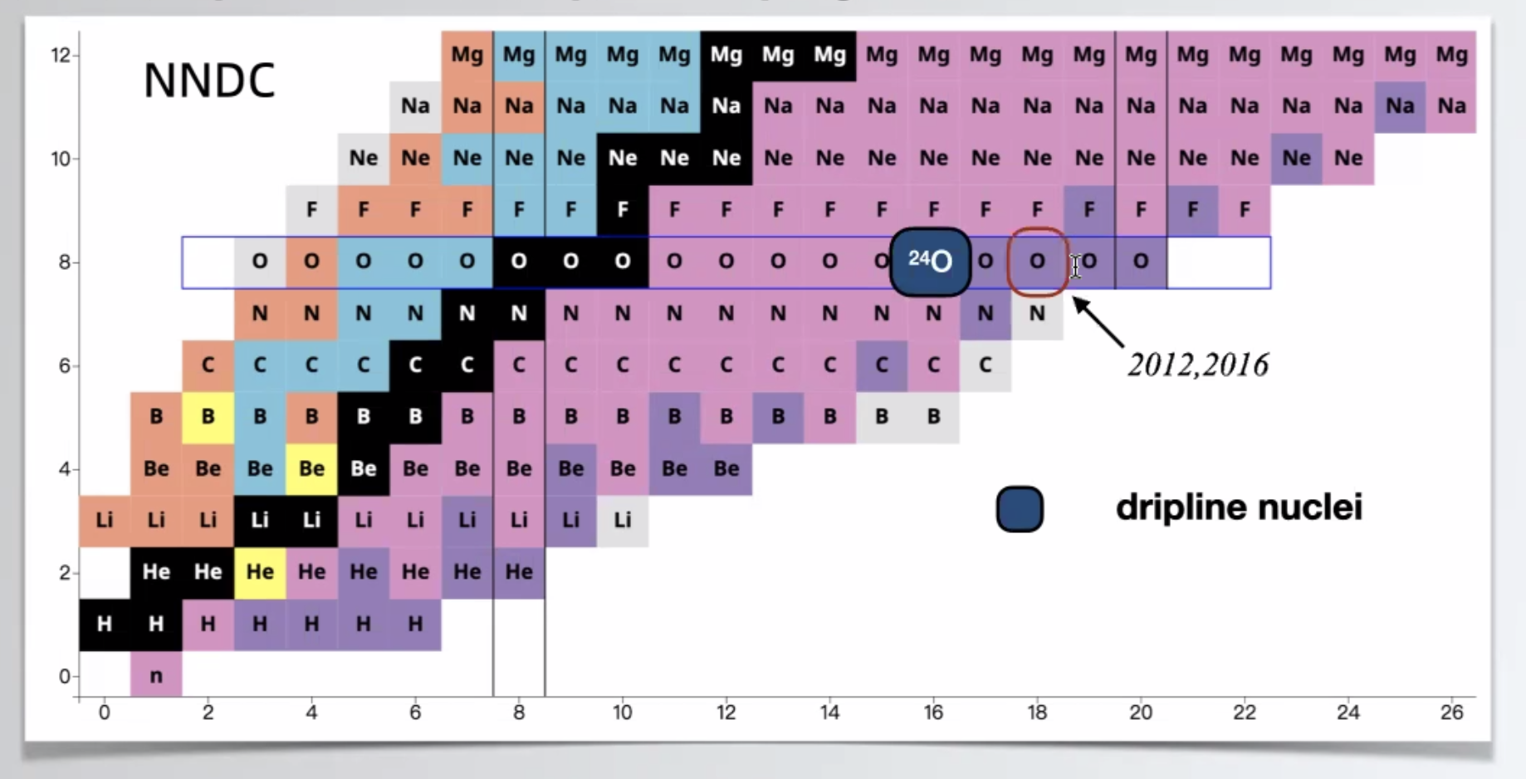
Nuclear Chart and Dripline
Can we explain the dripline of Carbon, Oxygen isotopes in NLEFT?
Role of 3-body force?

Slide 6
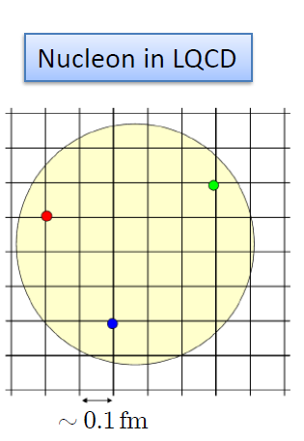
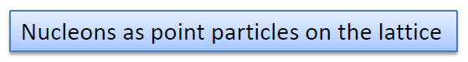
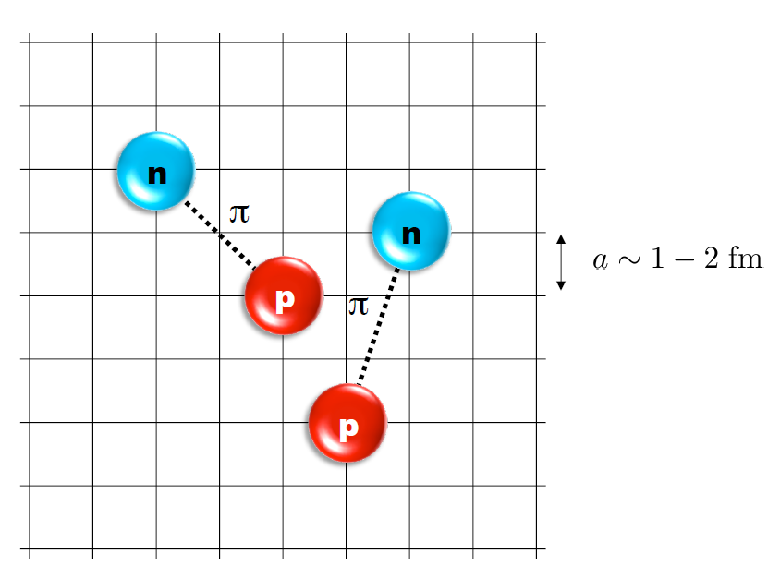
Nuclear Lattice Effective Field Theory
Ab initio method for Quantum many fermion system

Slide 7
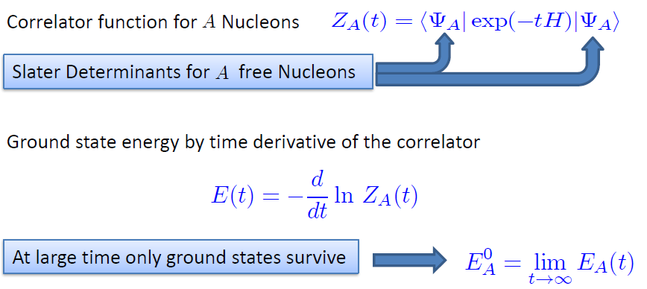
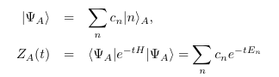
Basic of NLEFT

Slide 8
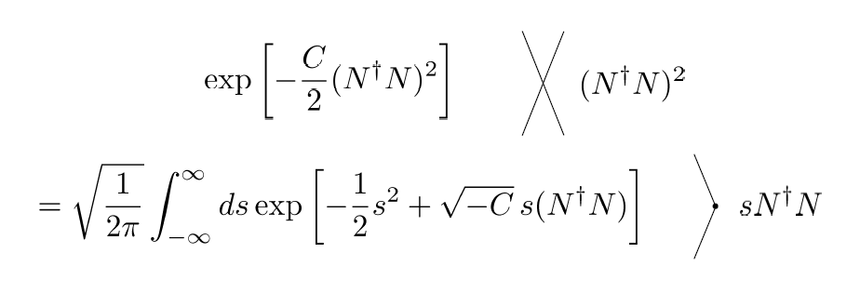
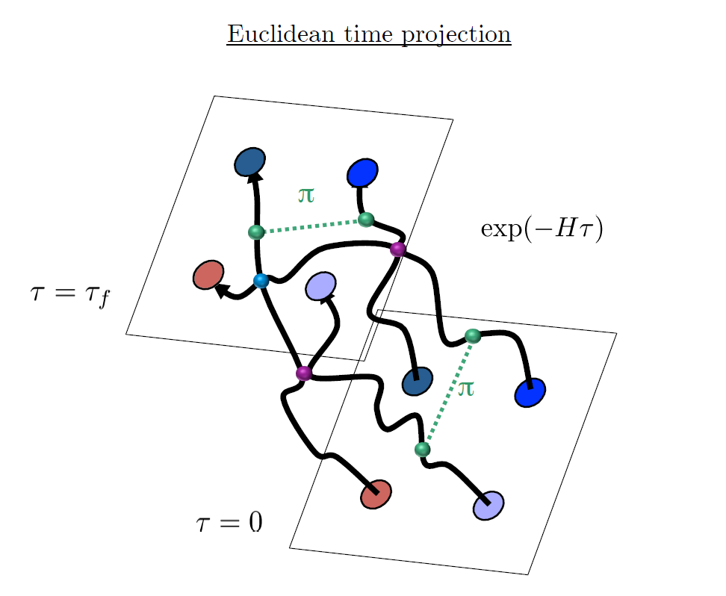
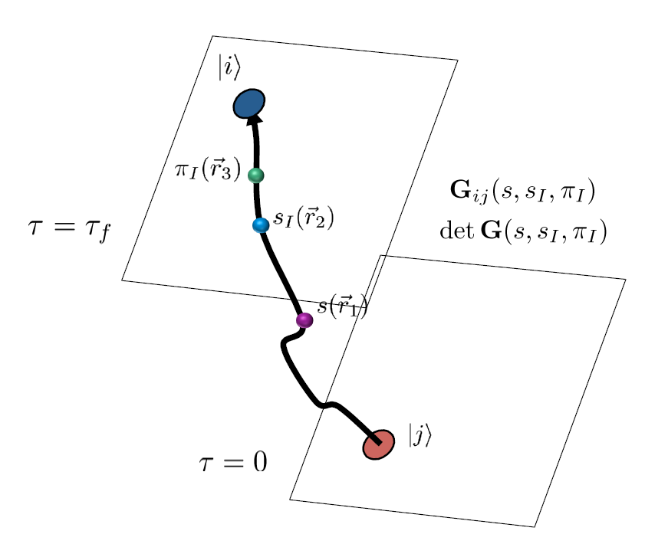
Auxiliary Field Monte Carlo
Interacting nucleons
Nucleons interacts with auxiliary fields
(no direct interaction between nucleons)
computing fermion
Correlator amplitude
Integration
over auxiliary fields
M.C. integral
(sampling auxiliary field)

Slide 9
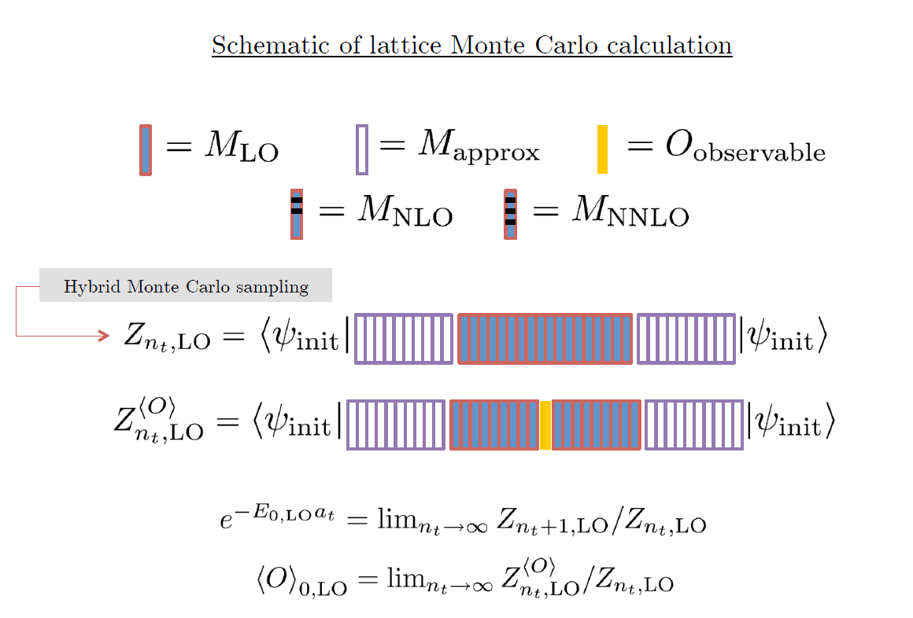

Slide 10
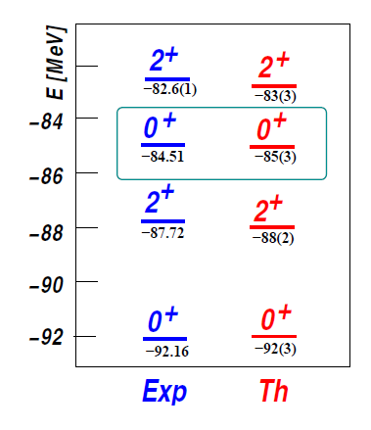
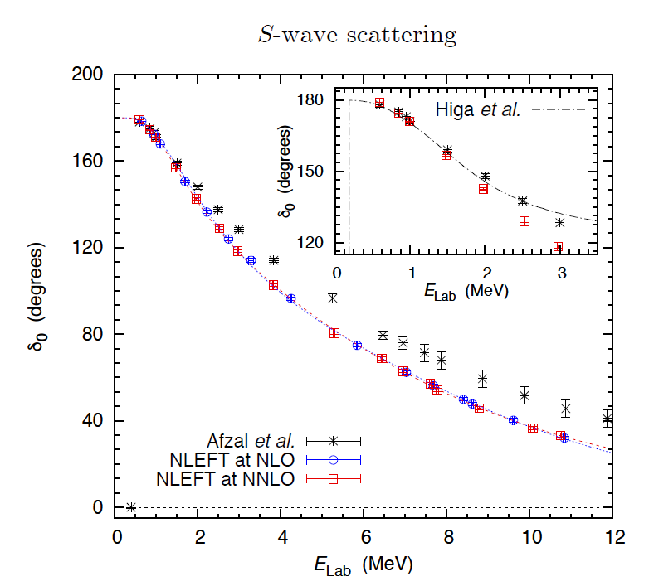
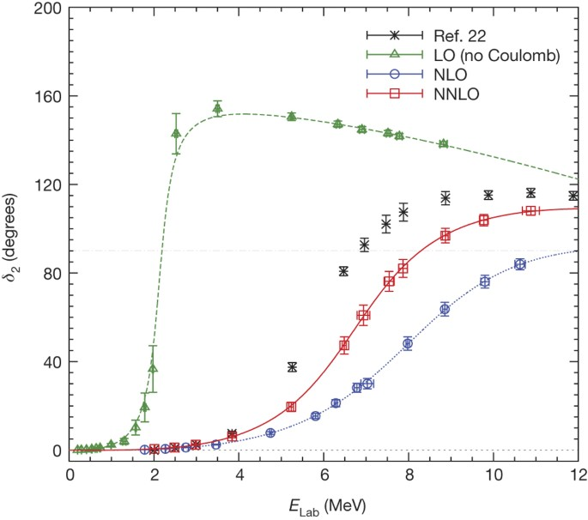
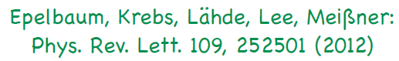
Applications of NLEFT
The first ab-initio calculation of
Hoyle state
Has been successfully applied to
Nuclear matter, Cold atom, dilute fermion system
Finite nuclei (A<=50)
First ab-initio calculation of Hoyle state
Cluster structure of ¹²C and ¹⁶O
NN scattering, N-D scattering
Alpha-alpha scattering
radiative capture, fusion
Etc.
Ab initio alpha-alpha scattering
( Nature 528, 111-114(2015))

Slide 11
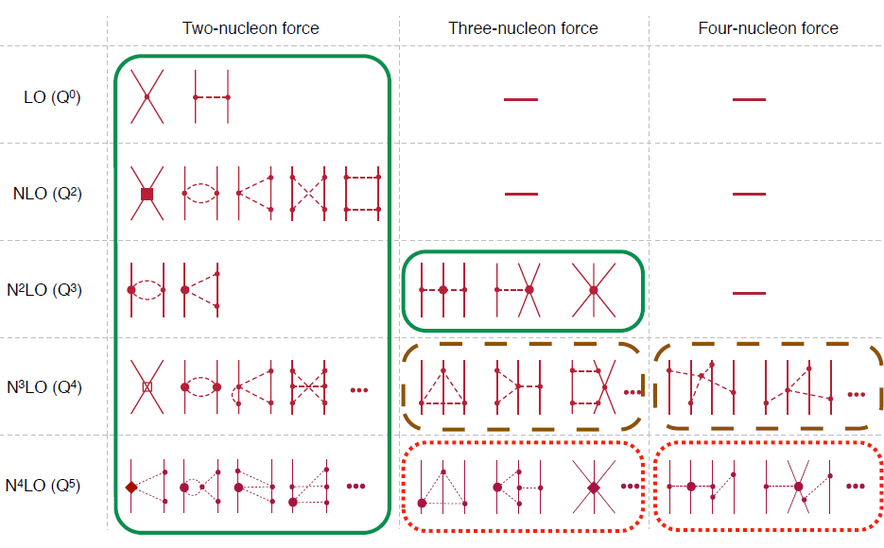
Chiral Effective Field Theory

Slide 12
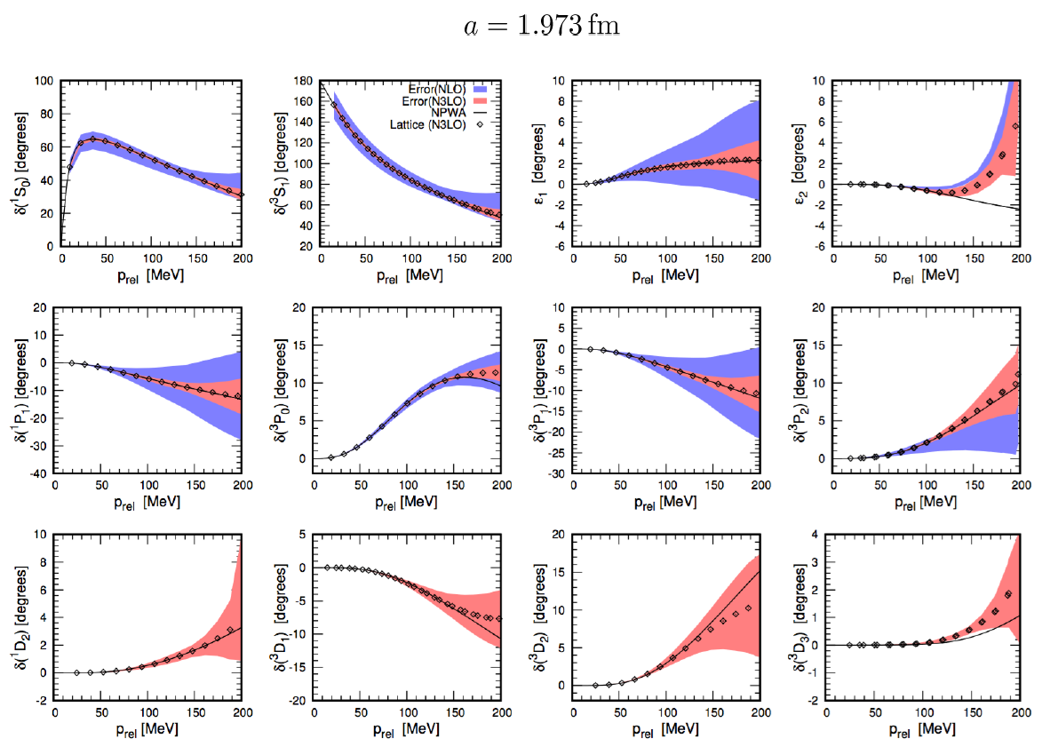
Determine LECs of NN interaction by fitting phase shifts of N-N scattering
Determine 3-body interaction by fitting the binding energy of A>=3 nuclei

Slide 13
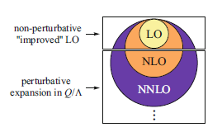
Lattice chiral Hamiltonian (N3LO)
Full N3LO Hamiltonian includes
Free Hamiltonian(Kinetic term)
Short range (nonlocal smeared) contact interactions up to Q^4 order
Isospin-breaking short range interactions
One pion exchange potential
Two pion exchange potential up to Q^4 order
Coulomb interaction
Long range isospin breaking interaction( isospin dependence in OPE)
Galilean Invariance Restoration (GIR) term (because of non-local interaction.)
Three nucleon interaction

Slide 14
Difficulty with full chiral interaction
Sign problem
NLEFT suffers sign problems at large Euclidean time limit
Large cancellation between positive and negative contributions→ large uncertainty.
SU(4) symmetric interaction does not have sign problem
One pion exchange and higher order chiral interaction
Difficulty with Asymmetric nuclei ( neutron rich isotopes.)
A new approach to reduce the sign problem.
→ Wave function matching Hamiltonian.

Slide 15
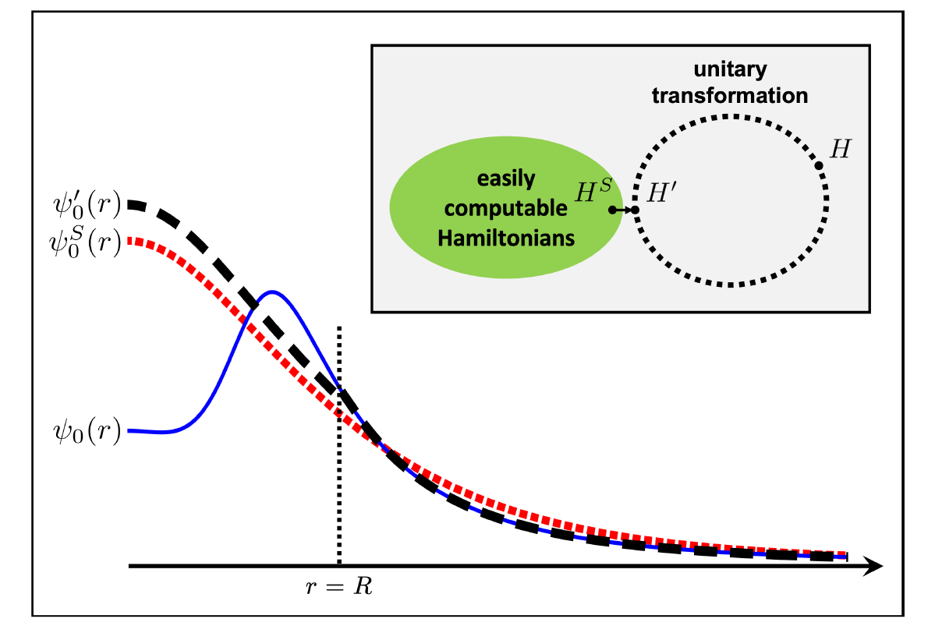
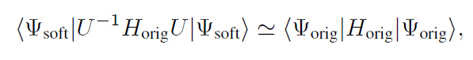
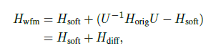
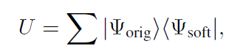
Wave function matching
H and H’ are fully equivalent to two-body observables (by Unitary transformation)
The goal is to make the perturbation expansion from “simple” wave function gives a good convergence
U is only active
At r < R

Slide 16
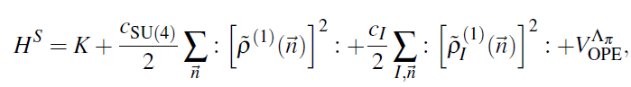
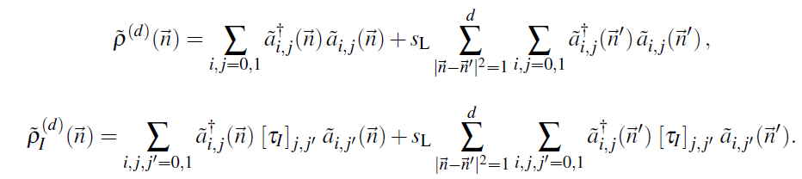
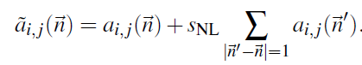
Wave function matching Hamiltonian
“Simple” Hamiltonian
(local,non-local smeared operators)

Slide 17
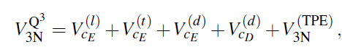
Wave function matching Hamiltonian
N3LO Hamiltonian
V_2N : short range NN interactions
W_2N: GIR restoration term for V_2N
V_2N,WFM : difference from H_s
W_2N,WFM: GIR restoration correction to V_2N,WFM
V_3N : contains short range 3N interaction parameters(to be fitted)
and two pion exchange correction to 3N

Slide 18
Lattice Calculation
We need to introduce a lattice scale in space and time:
momentum space cutoff ~ 150 MeV → lattice spacing a= 1.316 fm
Time cutoff ~ 1000 MeV
We need to determine Hamiltonian for the lattice size. (for given regularization scale.)
Two-body interaction coefficients can be determined from phase shifts of np scattering.
Three-body interaction can be fixed from binding energy of A>=3.
JUWELS at Julich Supercomputing Centre (JSC)
NURION at National Supercomputing Center of Korea (KSC-2021-CRE-0429, KSC-2022-CHA-0003, KSC-2023-CHA-0005 )

Slide 19
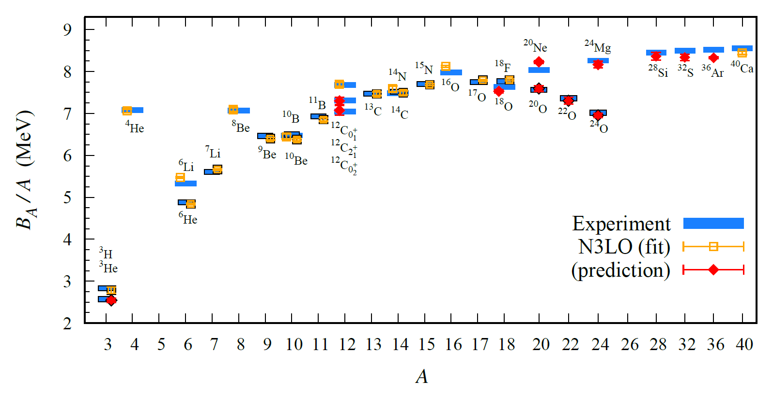
BE/A from WFM
Preliminary

Slide 20
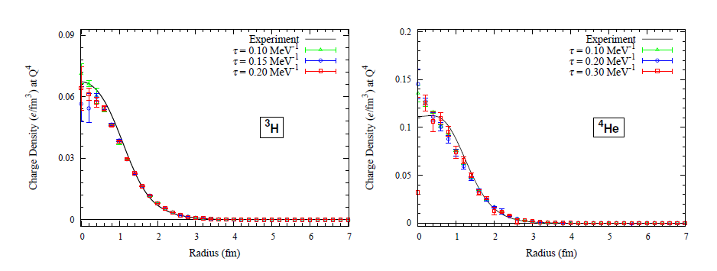
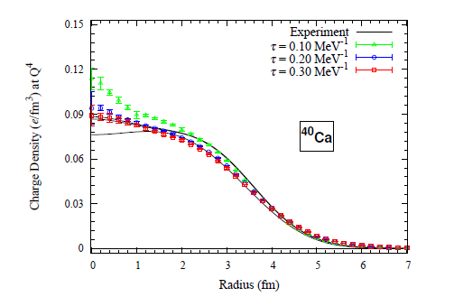
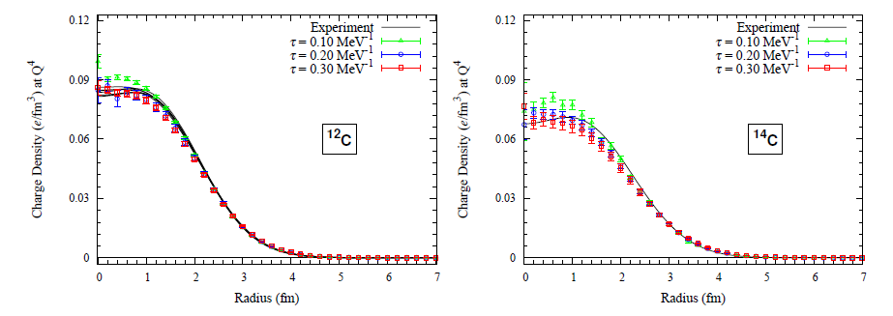
Charge density from WFM
Preliminary

Slide 21
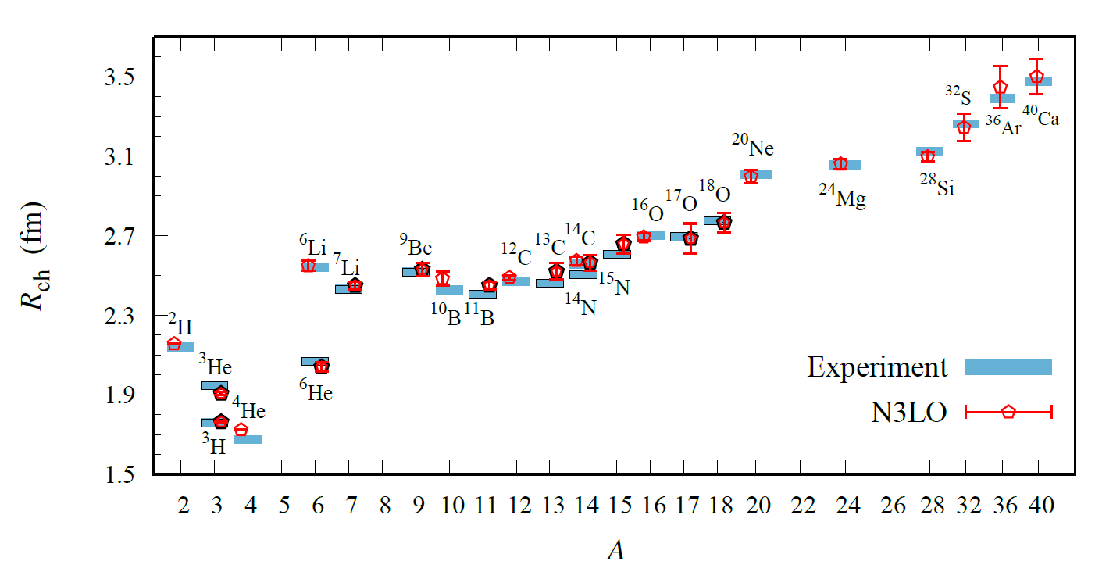
Charge Radius
Preliminary

Slide 22
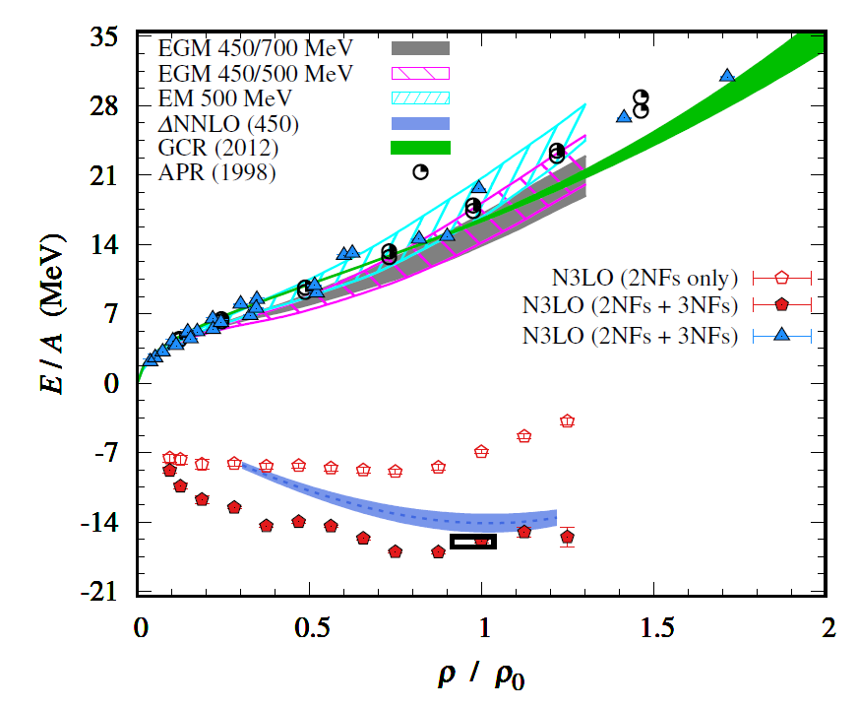
Nuclear/Neutron Matter
Neutron matter:
A=4~80
box size 6.6 ~ 13.2 fm.
Nuclear matter:
A=4 ~ 160
Box size 7.92~9.24 fm.
Preliminary

Slide 23
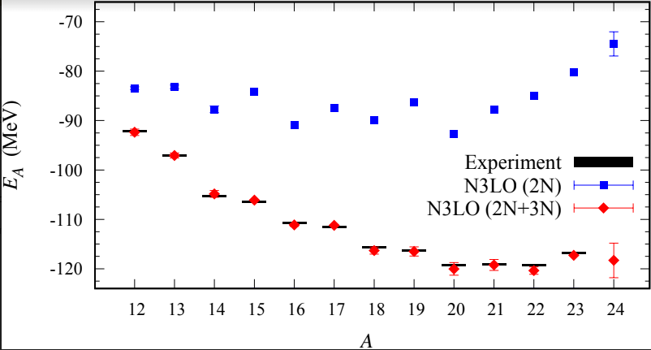
2N and 3N contributions ( Carbon isotopes)

Slide 24
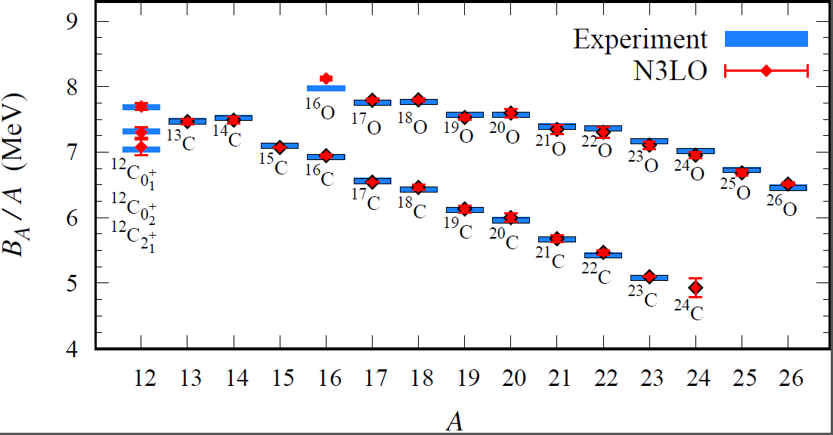
Carbon and Oxygen
Preliminary

Slide 25
Summary
Wave function matching method seems to be promising
New method to improve the N3LO calculation of NLEFT
Preliminary study shows promising results for wide range of observables in one scheme (same interaction and many-body method)
NN scattering
Binding energy (from 3H to 40Ca)
Symmetric Nuclear matter
Neutron matter
Dripline of Oxygen isotope.
Carbon excited states
Further investigation on the finite volume effects is on-going.
Also, Carbon isotopes, odd Oxygen isotopes, Cluster structure, excited states will be studied.

